Slide 1
Regression
Trading System
Main APP
1000+ components
login
New feature (update)
push to main
exchange
view stats
create bond
edit bond
- test again all components?
tons of manual testing $$$

Slide 2
Solution?
Instead of eight manual testers
Two QA Automation and One Tester
=

Slide 3
Automation
A
A
GETTING UP AUTOMATION
FRAMEWORK
WRITE AUTOMATION
SCRIPTS
GOOD MORNING!
INVESTIGATE AR
SCHEDULE NIGHTLY RUN
PREPARE JENKINS JOB
SPLIT AUTOMATION
ERR/ APP ERR
T/D
SEND APP ERRORS TO QA/DEV
Fix them and retest

Slide 4
Testing Trigger
GUI Tests
QA Automation
System Tests
Deploy
Microservice Tests
Dev
Unit Test

Slide 5
Test Cover
- Styling issues
- Elements presence
- Logical operations
=
- UI Actions
- Bad requests
- Security issues
- Entities creation

Slide 6
Automation

Slide 7
Automation Run
Grid
Nodes
1
2 scenarios
Repo with the code
Github
2
2 scenarios
Jenkins Job
selenium-grid
parallel
3
2 scenarios
4
2 scenarios
ex. 8 scenarios

Slide 8
Continuous Integration
● “Continuous Integration doesn’t get rid of bugs, but it does make them dramatically easier to find and remove.” - Martin Fowler, chief scientist, ThoughtWorks.
● Jenkins is just a framework, it achieves Continuous Integration by the help of Plugins. It provides support for over 1000 Plugins .

Slide 9
Continuous Integration

Slide 10
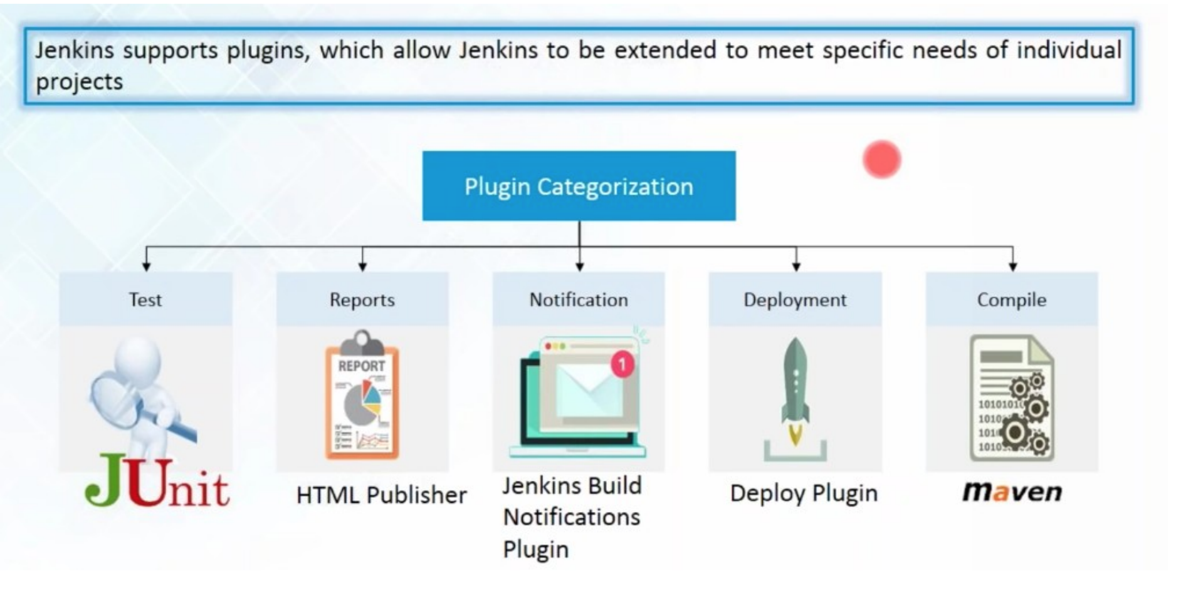
Jenkins

Slide 11
Jenkins

